Slide 1
National Strategy for Transformation (NST2)

Slide 2
Recap of the National Development Planning Framework
The entire framework is linked and interdependent, to succeed all levels must implement accordingly
The Vision integrates international and regional commitments of Rwanda including AU Agenda 2063, EAC Vision 2050, SDGs, etc.
Vision 2050
National Strategy for Transformation 2
5YGP/NST 2 (2024 – 2029)
Sector Strategic Plans/SSPs
(covering Specific areas e.g. health, education )
District Development Strategies/ DDS
(considering District/CoK Specificities)
MTEF, Annual action plans, budgets, Imihigo, M&E
‹#›

Slide 3
Lessons informing NST2 elaboration
  Achievement of NST1 was affected by a combination of shocks (Covid-19, Disasters and Inflation crisis) and implementation challenges
  NST2 builds on the lessons from the NST1 implementation and continues the drive towards Vision 2050
  NST2 needs to enhance the way of doing business
        Improve quality and scale
        Build resilience
        Integrate plans, programmes, projects & implement faster
        Enhance engagement of stakeholders e.g. private sector, CSOs, DPs, citizens, etc.

Slide 4
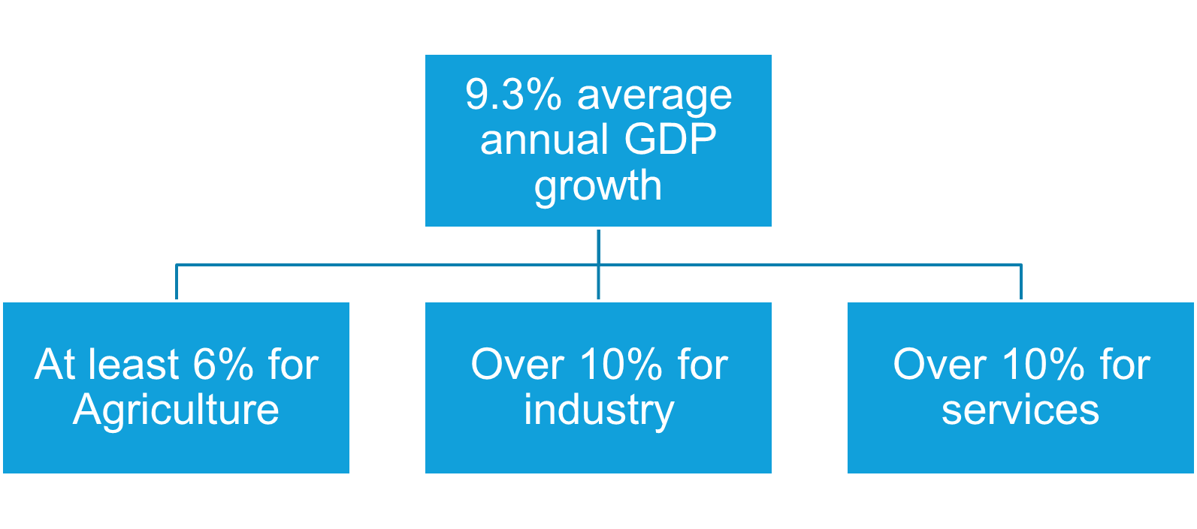
Macroeconomic requirements for NST2

Slide 5
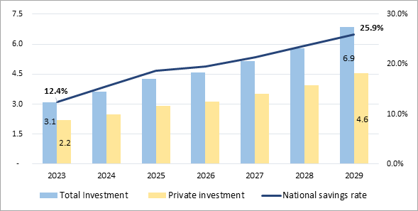
Macroeconomic requirements for NST2 cont’d
Increasing exports from USD 3.5 billion in 2023 to USD 7.3 billion in 2029 driven by tourism, mining, manufacturing, etc.
Increasing private investment from 2.2 Bn (15.9% of GDP) to 4.6Bn USD (21.5% of GDP)
More than doubling savings rate to 25.9%
Projections 2024-2029: Investment (in billion USD) – National Savings (in % of GDP)

Slide 6
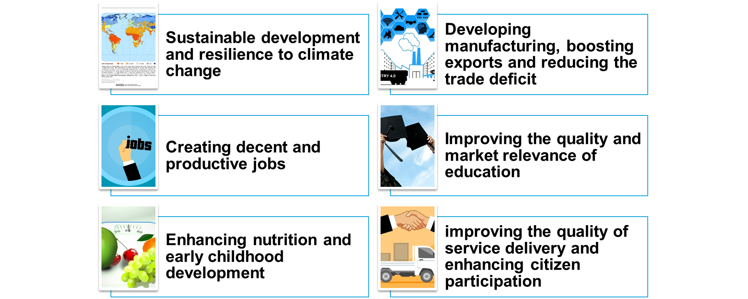
NST2 high impact results

Slide 7
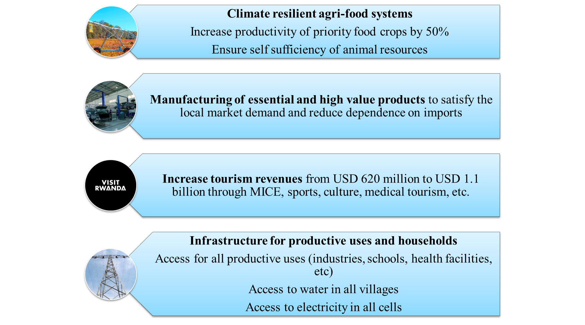
NST2 Economic Transformation priorities
‹#›
Notes:
‹#›

Slide 8
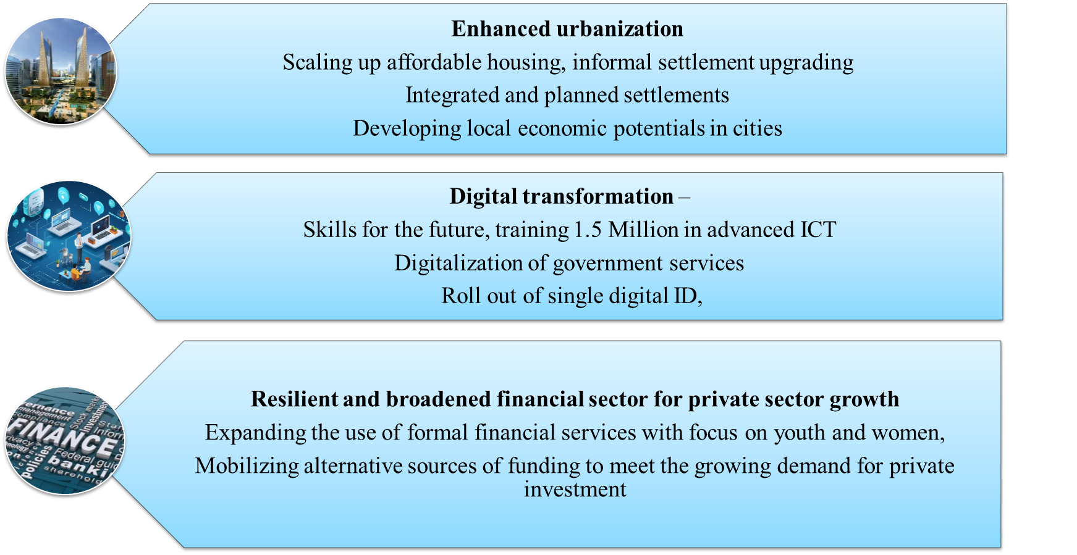
NST2 Economic Transformation priorities
Notes:
‹#›

Slide 9
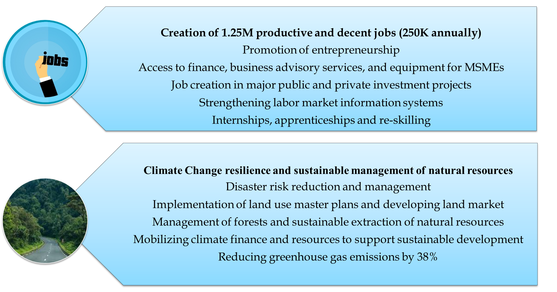
NST2 Economic Transformation priorities
Notes:
‹#›

Slide 10
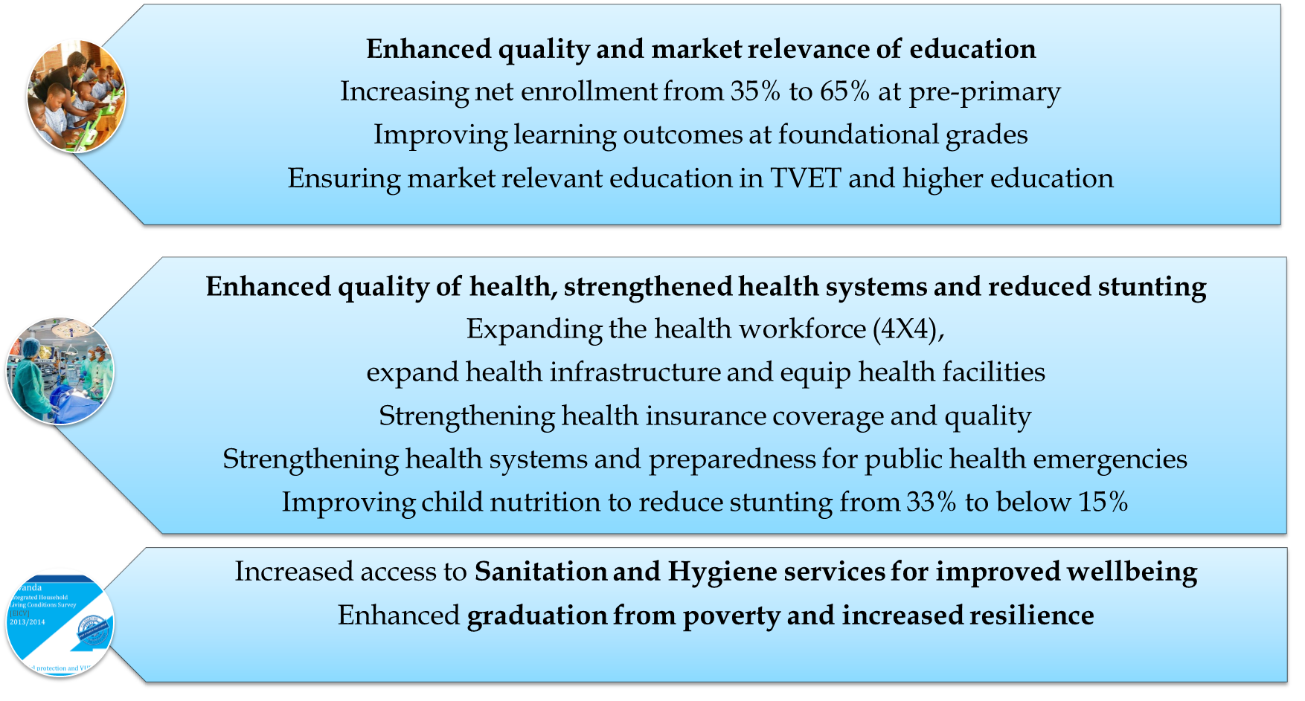
NST2 Social Transformation priorities
‹#›
Notes:
‹#›

Slide 11
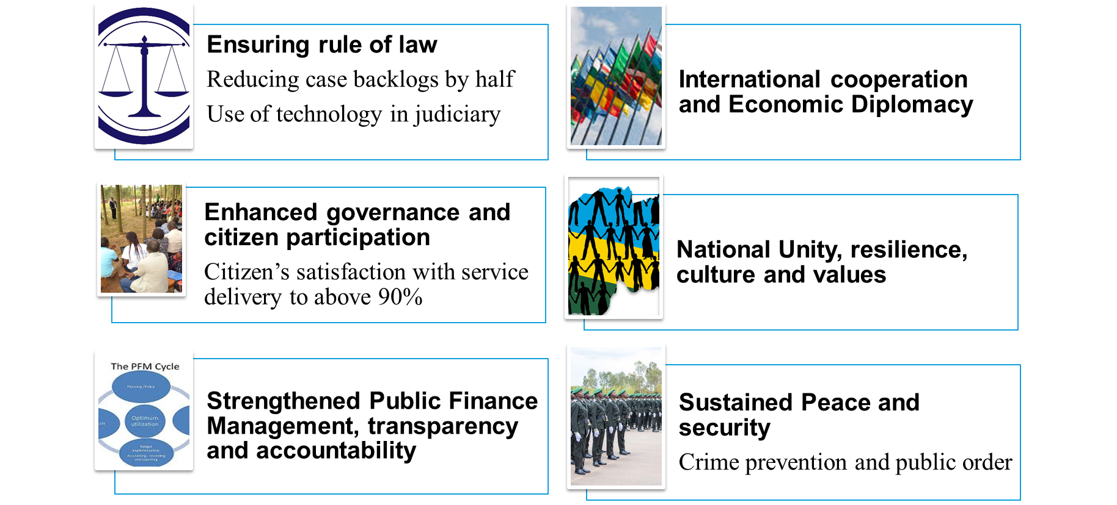
NST2 Transformational Governance priorities
‹#›
Notes:
‹#›

Slide 12
NST2 implementation enablers
Optimizing Governance structures
Strengthening of cross-institutional platforms ( Ministerial Clusters, SWGs & JADF).
Improving Private Sector & CSOs, citizens, DPs, engagement
Improving project execution and delivery through streamlining the functioning of SPIUs across institutions
Harnessing data and Technology
Strengthening integrated planning
Scaling up economic and spatial planning to ensure efficient allocation of resources
Strengthening automation of service delivery (Technology & digitaliization)
Data and statistics: Leveraging data to drive informed decisions
Strengthening Monitoring, Evaluation and Learning (MEL)
Building Innovation and Skills
Strengthening Innovation, Research for development
Prioritizing capacity and skills development across all sectors
‹#›

Slide 13
Critical success factors to build on
Visionary Leadership
Citizen centered good governance and accountability – engaging citizens, zero tolerance for corruption
Inclusive development model and leaving no one behind – gender equality, youth engagement, pro-poor plans, unity and solidarity, integration of PwDs, etc.
Home grown initiatives and innovations (e.g. Umuganda, Imihigo, IFMIS, e-procurement, etc).
Investment in human capital – education, health, capacity building in public and private sector
Results oriented institutional framework – effective performance management and ensuring delivery and implementation
Integrating ICT and innovation for enhanced service delivery, decision-making and productive use
Private Sector Participation – continuous engagement to accelerate their role
Sustaining Peace, Safety and security
‹#›

Slide 14
Thank you!

